Slide 1
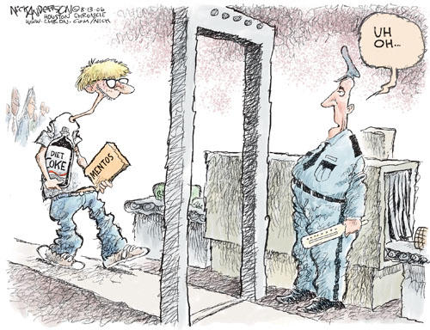
Types of Interactions

Slide 2
Today’s Date
Focus Questions:
1. What are the two main types of interactions?
Evidence: 1. Vocabulary
Interaction: When two objects act on or influence each other and their actions cause an effect
Types of Interactions

Slide 3
Evidence of Interactions
Any change in…
Color/Pattern
Motion
Location/Position
Sound
Shape/Size/Length
Light
Texture
Smell
Color
Temperature
Awesomeness
**explains that there was an interaction between two objects

Slide 4
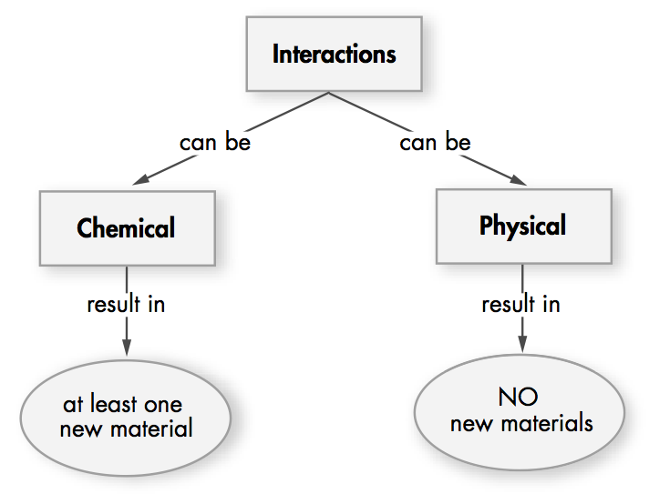
Chemists discovered that it is more useful to describe interactions of matter by defining 2 broad categories of interactions. These categories are based on the results of the interaction rather than what is required for the interaction.

Slide 5
Vocabulary (cont.)
Physical Interactions - any type of interaction that does NOT result in any new materials.
Chemical Interactions - any type of interaction that results in at least one new material.

Slide 6
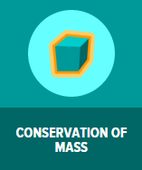
Watch This Brain Pop Video
Go to the Brain Pop App and watch
“Conservation of Mass” video
Record the definition for the following words:
Law of Conservation of Mass
Reactant
Product
Take the quiz and record your first quiz score on page 81 in your notes.

Slide 7
It was Mother’s Day, so Carlos and Isabel decided to cook lunch for their mother. Isabel first made a cake from a mix. She broke two raw eggs into the mix and added water. She put the cake dough in the oven to bake. Then she used a mixer to whip some cream for a frothy topping. Meanwhile, Carlos boiled an egg and cut up some vegetables and cheese for a salad. They decided to make and cook some hamburger patties and broil some French fries for lunch. When the French fries were a golden brown and the meat patties were no longer red and completely cooked, they called their parents. Carlos put ice cubes in four glasses of water, and they all sat down to eat. After the meal, they were ready for tea and dessert. Isabel boiled some water and poured it into the teapot with the tea bags. Almost everything was ready, but she couldn’t find the milk. Carlos searched and found the milk carton on the kitchen counter behind the mixing bowl. They had left it out earlier in the day. It smelled sour and had already started to curdle. But all was not lost! They mixed some of the whipped cream into their tea. Later, the scraps were placed in the garbage. But some things were added to the compost heap in the backyard. Papa washed the dishes in steaming hot water and Carlos dried them. While their food digested, they watched TV. The entire family agreed that they had enjoyed their lunch.

Slide 8
Identify the many…
There are many interactions in this story. Which are chemical interactions? Which are physical interactions? What is your evidence?

Slide 9
It was Mother’s Day, so Carlos and Isabel decided to cook lunch for their mother. Isabel first made a cake from a mix. She broke two raw eggs into the mix and added water. She put the cake dough in the oven to bake. Then she used a mixer to whip some cream for a frothy topping. Meanwhile, Carlos boiled an egg and cut up some vegetables and cheese for a salad. They decided to make and cook some hamburger patties and broil some French fries for lunch. When the French fries were a golden brown and the meat patties were no longer red and completely cooked, they called their parents. Carlos put ice cubes in four glasses of water, and they all sat down to eat. After the meal, they were ready for tea and dessert. Isabel boiled some water and poured it into the teapot with the tea bags. Almost everything was ready, but she couldn’t find the milk. Carlos searched and found the milk carton on the kitchen counter behind the mixing bowl. They had left it out earlier in the day. It smelled sour and had already started to curdle. But all was not lost! They mixed some of the whipped cream into their tea. Later, the scraps were placed in the garbage. But some things were added to the compost heap in the backyard. Papa washed the dishes in steaming hot water and Carlos dried them. While their food digested, they watched TV. The entire family agreed that they had enjoyed their lunch.
It was Mother’s Day, so Carlos and Isabel decided to cook lunch for their mother. Isabel first made a cake from a mix. She broke two raw eggs into the mix and added water. She put the cake dough in the oven to bake. Then she used a mixer to whip some cream for a frothy topping. Meanwhile, Carlos boiled an egg and cut up some vegetables and cheese for a salad. They decided to make and cook some hamburger patties and broil some French fries for lunch. When the French fries were a golden brown and the meat patties were no longer red and completely cooked, they called their parents. Carlos put ice cubes in four glasses of water, and they all sat down to eat. After the meal, they were ready for tea and dessert. Isabel boiled some water and poured it into the teapot with the tea bags. Almost everything was ready, but she couldn’t find the milk. Carlos searched and found the milk carton on the kitchen counter behind the mixing bowl. They had left it out earlier in the day. It smelled sour and had already started to curdle. But all was not lost! They mixed some of the whipped cream into their tea. Later, the scraps were placed in the garbage. But some things were added to the compost heap in the backyard. Papa washed the dishes in steaming hot water and Carlos dried them. While their food digested, they watched TV. The entire family agreed that they had enjoyed their lunch.

Slide 10
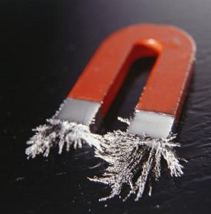
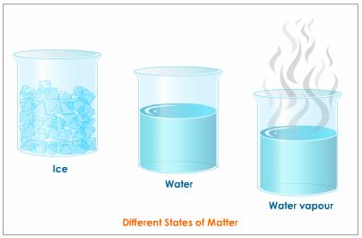
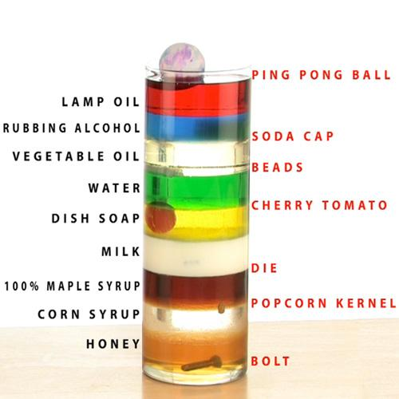
Physical Properties (review)
Remember that physical properties of matter are the properties of matter that can be observed or measured WITHOUT changing the identity of the matter.
Examples of Physical Properties
Appearance, Texture, Density, Melting and Boiling Point, Appearance, State, Magnetism, and many more

Slide 11
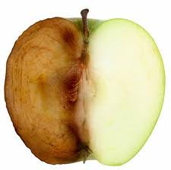
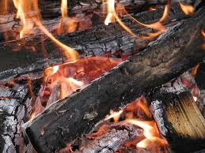
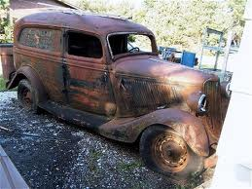
Chemical Properties (review)
Chemical properties describe a substance based on its ability to change into a new substance with different properties
Examples of Chemical Properties
Flammability, Reactivity with other matter, such as water, acids, or oxygen

Slide 12
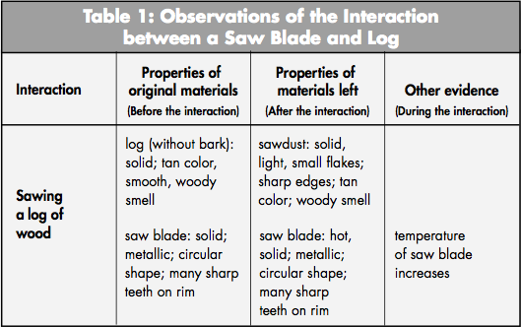
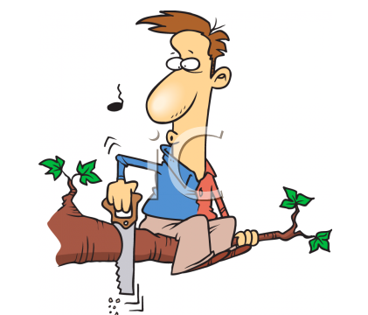
Sawing Interaction
Suppose you were sawing a log. The interacting objects are the saw blade and a log. Is this a chemical interaction (results in new material) or a physical interaction (does not result in new material)? To answer this question, you need to compare the properties of the original materials (saw blade and log) and the properties of the materials after the interaction (saw blade and sawdust). What physical properties change? Do chemical properties of the saw or of the wood change?

Slide 13
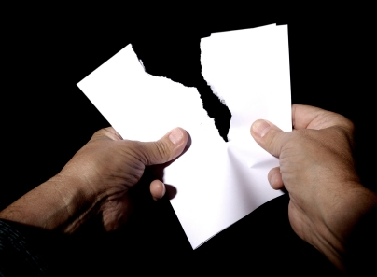
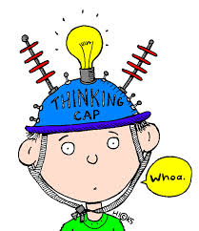
Tearing Interaction
Do the physical properties of the original sheet change? Do the chemical properties of the original sheet and the 2 pieces of torn paper change?

Slide 14
What do you think
Is the sawing interaction physical or chemical?
Is the tearing interaction physical or chemical?
What evidence from both examples suggests that these were both physical interactions?
Correct – Nothing NEW was created from the interaction, just a different shape and size of the wood and paper. The original material is still the same.

Slide 15
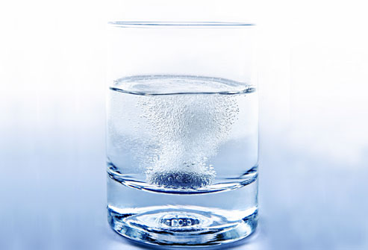
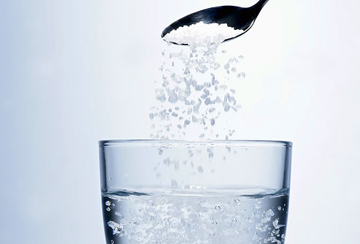
Now consider these interactions
Adding salt to water
Adding Alka-Seltzer tablets to water

Slide 16
When salt is dissolved in water, is the solution a mixture or a single substance?
What happened to the solid salt?
Can you get the original materials back with another interaction?
Is this a chemical or a physical interaction?

Slide 17
When you put the Alka-Seltzer tablet in the water, it will disappear. The mixture will bubble, making a gas called carbon dioxide. The liquid left in the flask will taste sour and have a sharp smell.
Is there anything NEW?
Is this a chemical or a physical interaction?

Slide 18
Because it is sometimes difficult to determine if an interaction is chemical or physical, chemists often use another piece of evidence to decide. The evidence is how easy it is to reverse the interaction (get the original substances back) with another physical interaction.
Can the dissolved salt be removed from the water?
Most chemical interactions cannot be reversed with a physical interaction. If you dissolved the Alka-Seltzer tablet in water and collected all of the gas, and put the carbon dioxide gas and the liquid together, would you get the original tablets back?

Slide 19
2. Types of Interactions
Draw this table in your notebook on page 81 after your definition of “Product”. Label it as evidence #2

Slide 20
So what is the difference?
(record the red text under the table you just drew
Physical Interactions
(Physical Change)
Chemical Interactions
(Chemical Change)
At least one NEW substance is created
New substance(s) have a different set of properties from the original properties
Cannot be reversed with another physical interaction
Examples: Burning wood, Alka-Seltzer and water, Rusting
NO NEW substance is created after interaction
Does not change the physical identity of the original material
Can be reversed with another physical interaction
Examples: Melting ice cream, sawing wood, boiling water

Slide 21
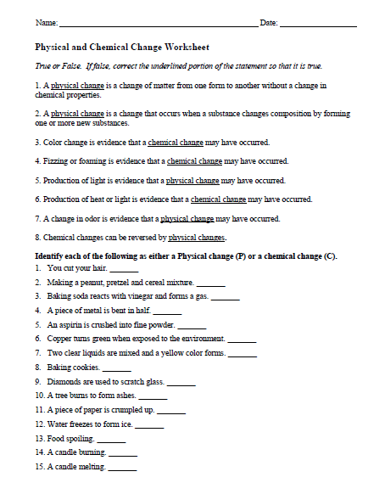
Next…
Complete the “Physical and Chemical Change” worksheet – front and back
Get stamped by Mr. B when completed
Tape it on page 80 when completed

Slide 22
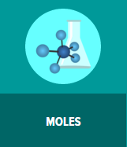
If you have time…
Watch the Brain Pop video
It explains how scientist know how many atoms are in a sample of a substance.
Go to the app and watch “Moles”

